Slide 1
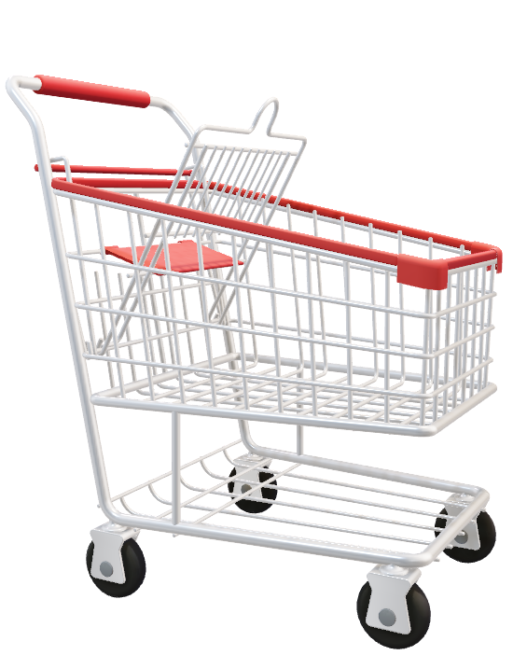
E – Commerce Website
By Team Azgar

Slide 2
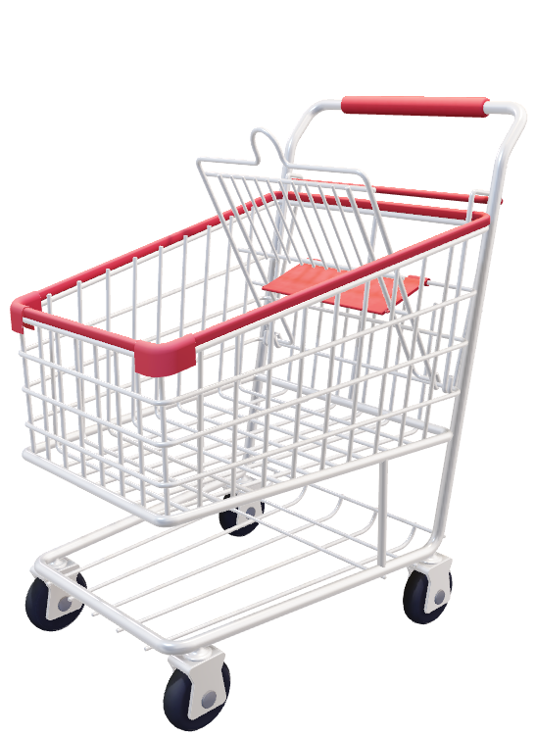
Team Azgar
Ashika Srivastava E23CSEU1892
Shreya Tripathi E23CSEU1918
Shardul Dhekane E23CSEU1896

Slide 3

Presenting -
NILE
An e-commerce site to make shopping experience smoother and easier

Slide 4
KEY FEATURES
User-Friendly Navigation
Customers can find what they're looking for quickly and intuitively.
Clear and Concise Product Descriptions
It provides accurate and informative descriptions that highlight the features and benefits of products.
Shopping Cart and Secure Checkout
The shopping cart is easy to use and allow customers to review their selections before checkout.
Account Creation
Enable customers to create accounts to store their information for faster checkout and order tracking.

Slide 5
Technology Stack Overview
BACKEND
Core java, JDBC, JSP, Servlet
FRONTEND
HTML, CSS, JAVASCRIPT
DATABASES
MySQL

Slide 6
Java Technologies Used
JDBC
JDBC allows the e-commerce application to interact with the database to manage product information, Customer Accounts, Order Processing and Shopping Cart Management.
JSP
It allows you to define the overall structure of your web page using HTML, while dynamically populating content and adding interactivity using embedded Java code. This simplifies web development in Java environments.
SERVELET
Servlets act like mini-programs that handle these requests on the server-side. It can access data from various sources, like databases (JDBC), process the information, and generate a dynamic response.

Slide 7
Registered?
No
Start
User Registration
Yes
Login
Shop
No
Acc Status
Logout
Yes
Yes
View/Search Item
View Account
Add Items to Cart
Display Cart
Change Cart items
Yes
Change Item Quantities
Yes
Checkout
No

Slide 8
Thank You

